Slide 1
Is it an evolution or creation or both ?
Phakamani Buthelezi
Chief Executive Officer

Slide 2
Presentation layout
1. BOCMA area
2. Background
3. A step that determines the future
4. Seven commandments
5. Performance
6. AG audits

Slide 3
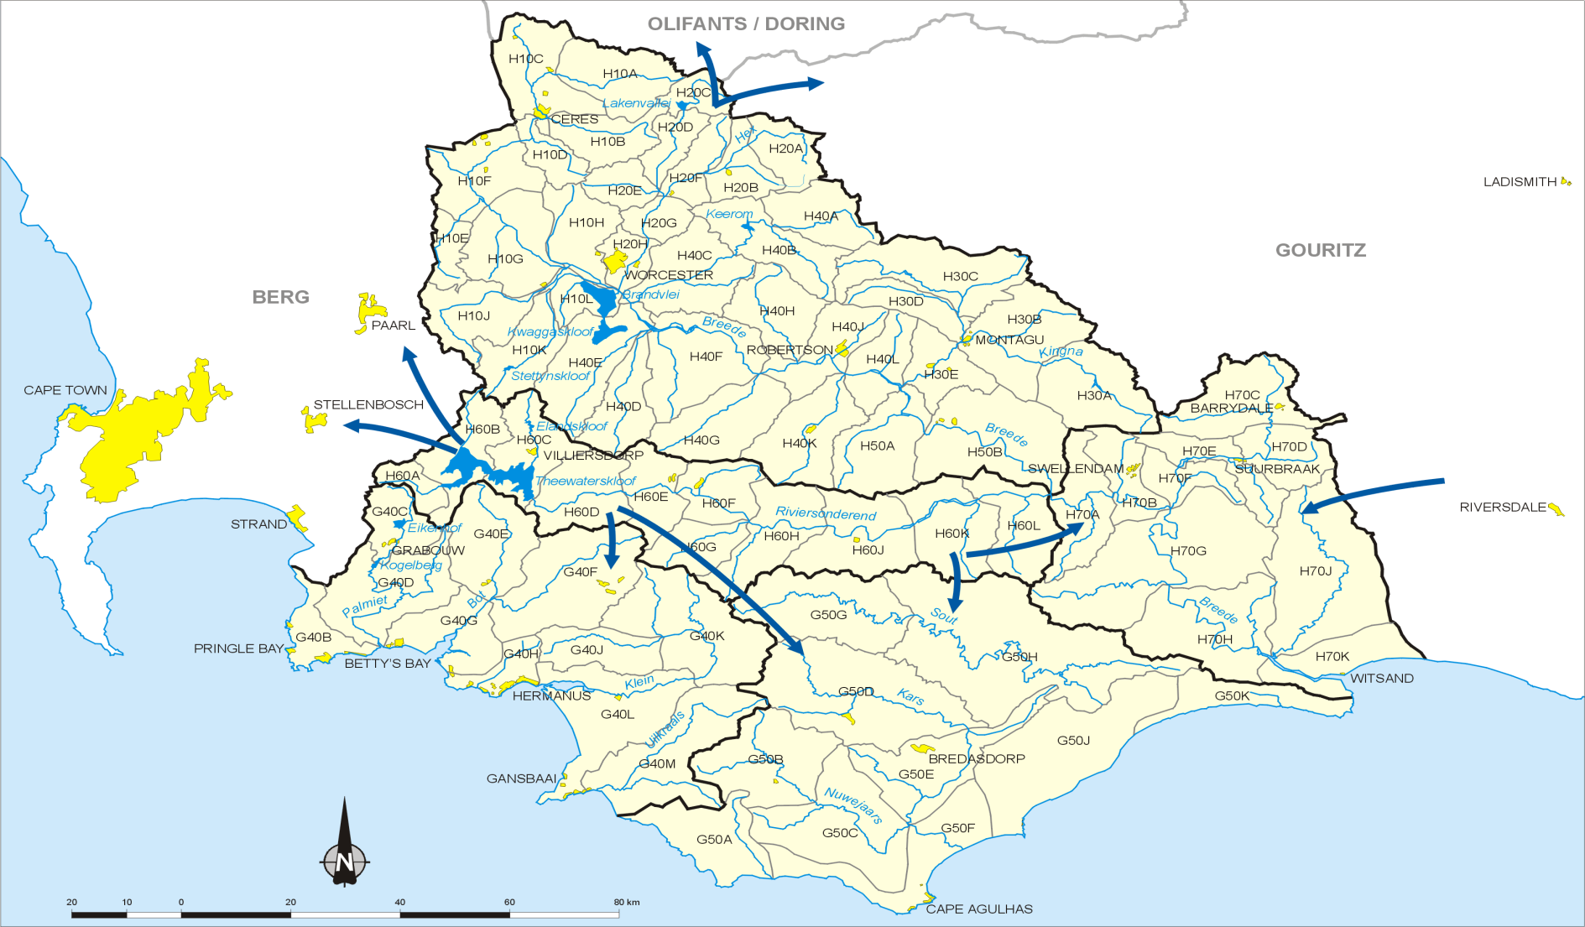
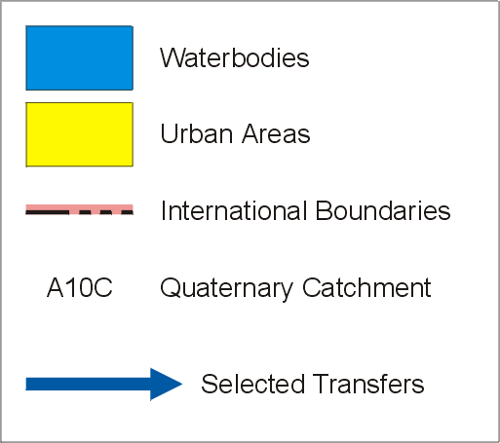
The Breede-Overberg Catchment Management Area

Slide 4
Background to the BOCMA
The BOCMA was established in terms of the NWA in July 2005.
Representative Board was appointed in September 2007.
Initial Functions in terms of section 80 of the NWA.
Additional functions delegated by the Minister on 17/12/2010.

Slide 5
A step that determines the future
Infrastructure – Office accommodation, IT, delegations, minimum guidelines, etc.
DWA’s support is key to CMA creation and evolution – Operational / Reporting lines
Internal control – make it happen on day one
Stakeholder engagements a catalyst for credibility
Commitment to change – Enhancing DWA’s role
Structure must be correct – Committees, Organogram, remuneration

Slide 6
Engagements
Invest in people
Understanding transformation – People involvement: CMS
- Irrigation boards to WUAs
- Transformation dialogues

Slide 7
Seven commandments
Water resources planning – CMS, land use
Water use management – Licensing, control & compliance of water use
Institutional engagement – stakeholder engagement, institutional cooperation
Water allocation reform – The Cape Example on land reform
Water resource protection – water quality monitoring
Strategic support - Information systems, HR, Finance
Management and governance

Slide 8
PERFORMANCE AGAINST TARGETS

Slide 9
AG audit EXPECTATIONS
THE BREEDE-OVERBERG CATCHMENT MANAGEMENT AGENCY RECEIVED UNQUALIFIED AUDITS SINCE INCEPTION

Slide 10
Thank you dankie enkosi
The end.

